Slide 1
Machine Learning DSECL ZG565
Dr. Chetana Gavankar, Ph.D,
IIT Bombay-Monash University Australia
Chetana.gavankar@pilani.bits-pilani.ac.in

Slide 2
Session 1
Date – 30th August 2020
Time – 2pm to 4pm
These slides are prepared by the instructor, with grateful acknowledgement of Tom Mitchell, and many others who made their course materials freely available online.

Slide 3
Session Content
Objective of course
Evaluation Plan
What is Machine Learning?
Application areas of Machine Learning
Why Machine Learning is important?
Design a Learning System
Issues in Machine Learning

Slide 4
Objective of course
Introduction to the basic concepts and techniques of Machine Learning
Gain experience of doing independent study and research in the field of Machine Learning
Develop skills of using recent machine learning software tools to evaluate learning algorithms and model selection for solving practical problems
30 August 2020

Slide 5
What We’ll Cover in this Course
Supervised learning algorithms
Regression
Naïve Bayes
Logistic regression
Decision Tree (Random Forest)
Neural networks
Support vector machines
Unsupervised learning
Clustering
Dimensionality reduction
Applications
Ensemble Learning
Unsupervised learning
Evaluation
Applications
Combining Classifiers

Slide 6
Books
Text books and Reference book(s)
T1 | Tom M. Mitchell: Machine Learning, The McGraw-Hill Companies
T2 | Christopher M. Bhishop: Pattern Recognition & Machine Learning, Springer
R1 | C.J.C. BURGES: A Tutorial on Support Vector Machines for Pattern Recognition, Kluwer Academic Publishers, Boston.
30 August 2020
Notes:
The requirements of information security within an organization have undergone two major changes in the last several decades. Before the widespread use of data processing equipment,the security of information felt to be valuable to an organization was provided primarily by physical (eg. rugged filing cabinets with locks) and administrative mechanisms (eg. Personnel screening procedures during hiring process).
Growing computer use implies a need for automated tools for protecting files and other information stored on it. This is especially the case for a shared system, such as a time-sharing system, and even more so for systems that can be accessed over a public telephone network, data network, or the Internet.
The second major change that affected security is the introduction of distributed systems and the use of networks and communications facilities for carrying data between terminal user and computer and between computer and computer. Network security measures are needed to protect data during their transmission.

Slide 7
Evaluation Plan
Name | Type | Weight
Quiz-I | Online | 5%
Assignment-I | Take Home | 13%
Assignment-II | Take Home | 12%
Mid-Semester Test | Closed Book | 30%
Comprehensive Exam | Open Book | 40%
Please note there will be no change in submission dates for quiz and assignment
30 August 2020

Slide 8
Lab Plan
Lab No. | Lab Objective
1 | Linear Regression and Gradient Descent Algorithm
2 | Naïve Bayes Classifier
3 | Logistic Regression Classifier
4 | Decision Tree
5 | Neural Network
6 | SVM
Labs not graded
Lab recordings available at CSIS virtual labs
Webinars will be conducted for lab sessions
Labs will be conducted in Python

Slide 9
Machine Learning
Machine learning is a scientific discipline that explores the construction and study of algorithms that can learn from data.
Such algorithms operate by building a model based on inputs and using that to make predictions or decisions, rather than following only explicitly programmed instructions.
30 August 2020

Slide 10
A Few Quotes
“A breakthrough in machine learning would be worth ten Microsofts” (Bill Gates, Chairman, Microsoft)
“Machine learning is the next Internet” (Tony Tether, Director, DARPA)
“Web rankings today are mostly a matter of machine learning” (Prabhakar Raghavan, Dir. Research, Yahoo)
“Machine learning is going to result in a real revolution” (Greg Papadopoulos, CTO, Sun)
“Machine learning is today’s discontinuity” (Jerry Yang, CEO, Yahoo)

Slide 11
Traditional Programming
Computer
Data Program
Output
Machine Learning
Computer
Data Output
Program
Slide credit: Pedro Domingos

Slide 12
What is Machine Learning?
Definition by Tom Mitchell (1998):
"A computer program is said to learn from experience E with respect to some class of tasks T and performance measure P, if its performance at tasks in T, as measured by P, improves with experience E.” Example: playing checkers.
E = the experience of playing many games of checkers
T = the task of playing checkers.
P = the probability that the program will win the next game.
30 August 2020

Slide 13
What is Machine Learning?
To have a learning problem, we must identify
The class of tasks
The measure of performance to be improved
Source of experience
30 August 2020

Slide 14
Example of Learning Problems
30 August 2020

Slide 15
A Checker Learning Problem
Task T: Playing Checkers
Performance Measure P: Percent of games won against opponents
Training Experience E: To be selected ==> Games Played against itself
30 August 2020

Slide 16
A handwriting recognition learning problem
Task T: recognizing and classifying handwritten words within images
Performance measure P: percent of words correctly classified
Training Experience E: a database of handwritten words with given classifications
30 August 2020

Slide 17
A robot driving learning problem
Task T: driving on public four-lane highways using vision sensors
Performance measure P: average distance travelled before an error (as judged by human)
Training experience E: a sequence of images and steering commands recorded while observing a human driver
30 August 2020

Slide 18
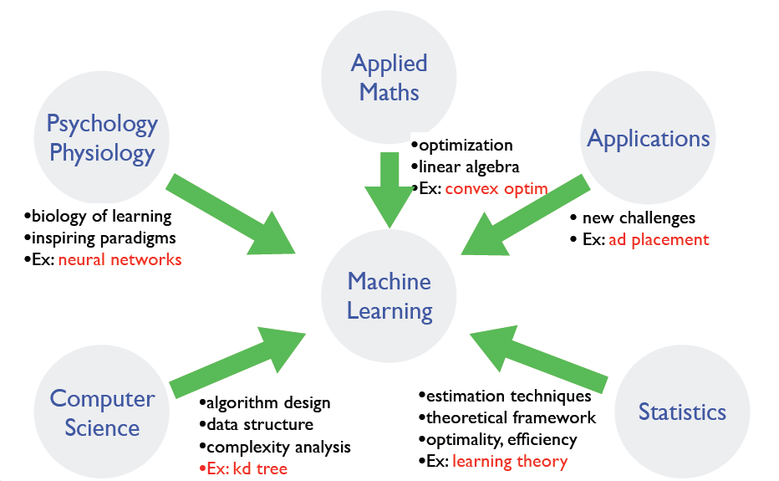
Where does ML fit in?
Slide credit: Dhruv Batra, Fei Sha

Slide 19
Why is Machine Learning Important?
Some tasks cannot be defined well, except by examples.
Relationships and correlations can be hidden within large amounts of data. Machine Learning may be able to find these relationships.
Human designers often produce machines that do not work as well as desired in the environments in which they are used.
30 August 2020

Slide 20
Why is Machine Learning Important ?
The amount of knowledge available about certain tasks might be too large for explicit encoding by humans (e.g., medical diagnostic).
New knowledge about tasks is constantly being discovered by humans. It may be difficult to continuously re-design systems “by hand”.
30 August 2020

Slide 21
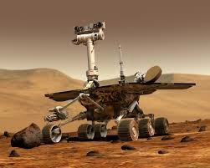
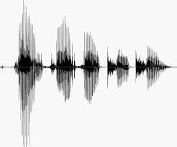
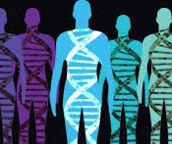
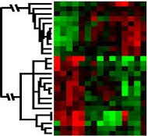
When Do We Use Machine Learning?
ML is used when:
Human expertise does not exist (navigating on Mars)
Humans can’t explain their expertise (speech recognition)
Models must be customized (personalized medicine)
Models are based on huge amounts of data (genomics)
Learning isn’t always useful:
There is no need to “learn” to calculate payroll
Slide Credit: Eric Eaton

Slide 22
Application Domains
Web search
Computational biology
Finance
E-commerce
Space exploration
Robotics
Information extraction
Social networks
Language Processing
Many more emerging…
Slide credit: Pedro Domingos

Slide 23
State of the Art Applications of Machine Learning
.

Slide 24
Application Types
Medical diagnosis
Credit card applications or transactions
Fraud detection in e-commerce
Worm detection in network packets
Spam filtering in email
Recommended articles in a newspaper
Recommended books, movies, music, or jokes
Financial investments
DNA sequences
Spoken words
Handwritten letters
Astronomical images
Slide credit: Ray Mooney

Slide 25
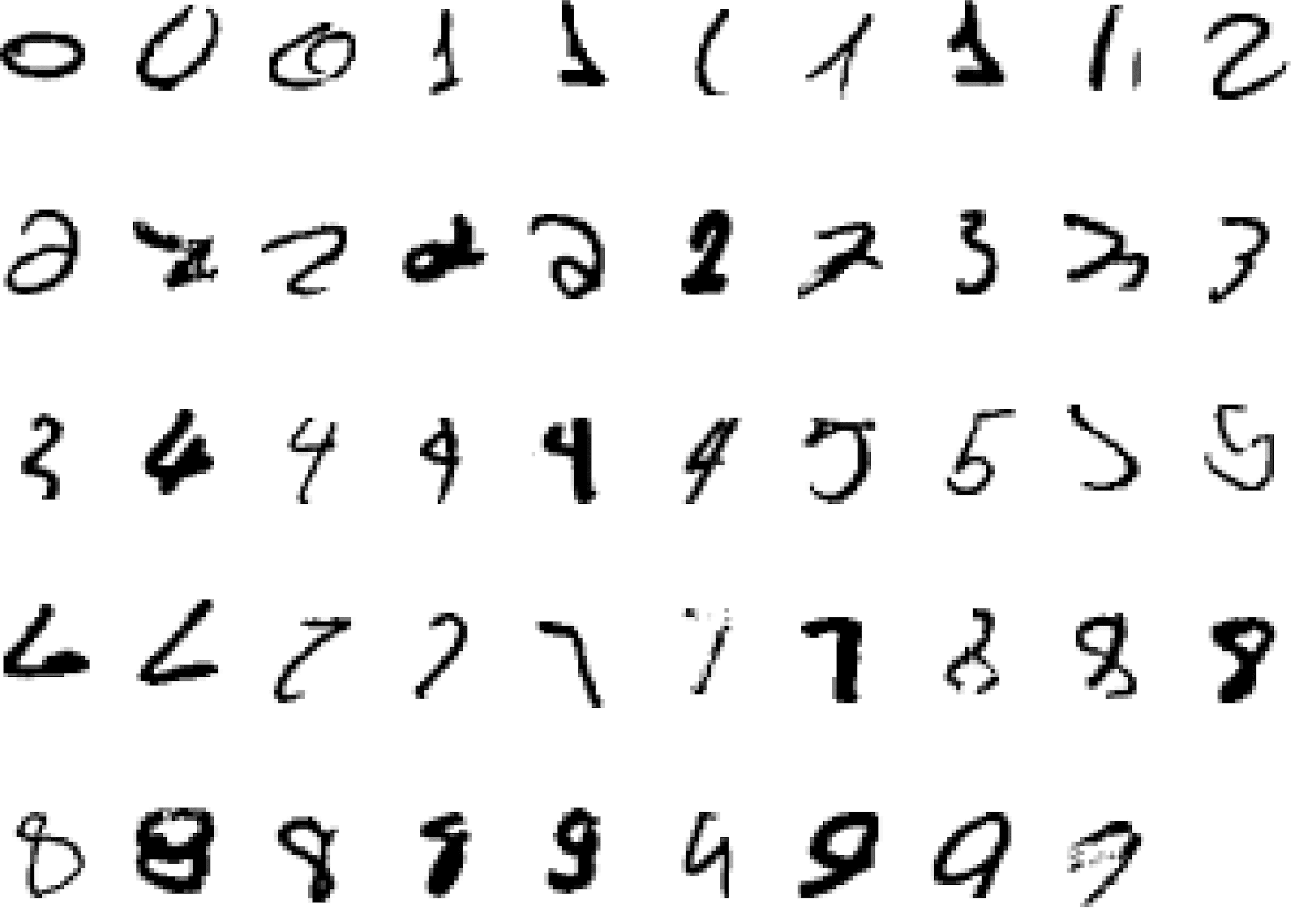
It is very hard to say what makes a 2
Pattern recognition
Slide credit: Geoffrey Hinton

Slide 26
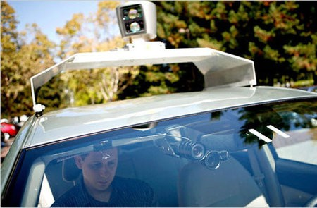
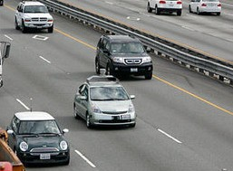
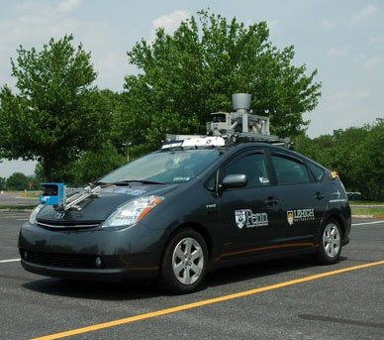
Autonomous Cars
Nevada made it legal for autonomous cars to drive on roads in June 2011
As of 2013, four states (Nevada, Florida, California, and Michigan) have legalized autonomous cars
UPenn’s Autonomous Car →
Slide credit: Eric Eaton

Slide 27
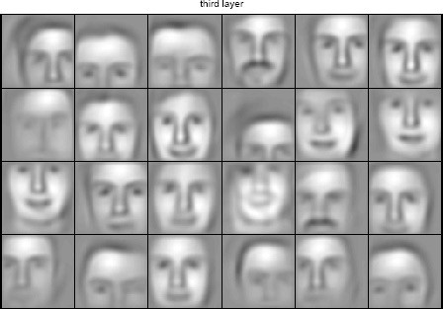
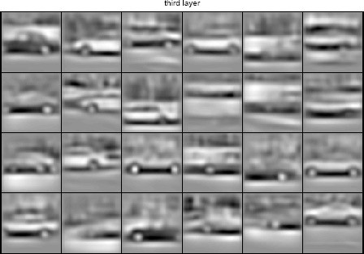
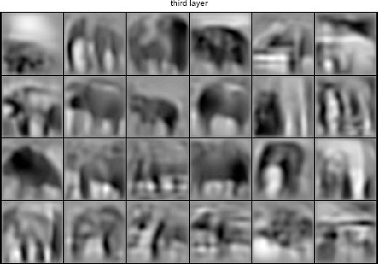
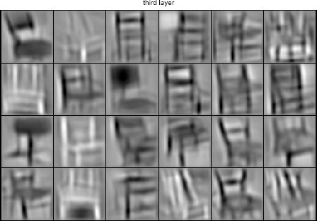
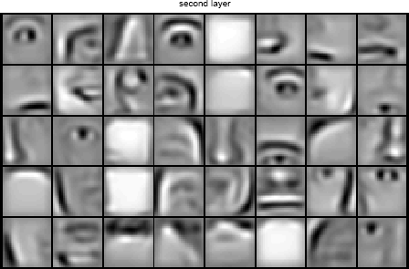
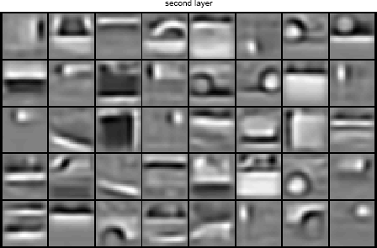
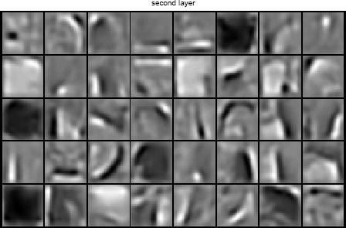
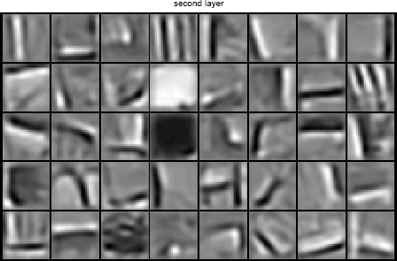
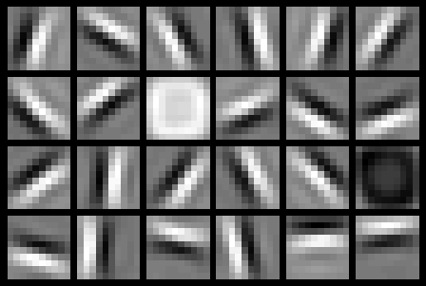
Learning of Object Parts
Slide credit: Andrew Ng

Slide 28
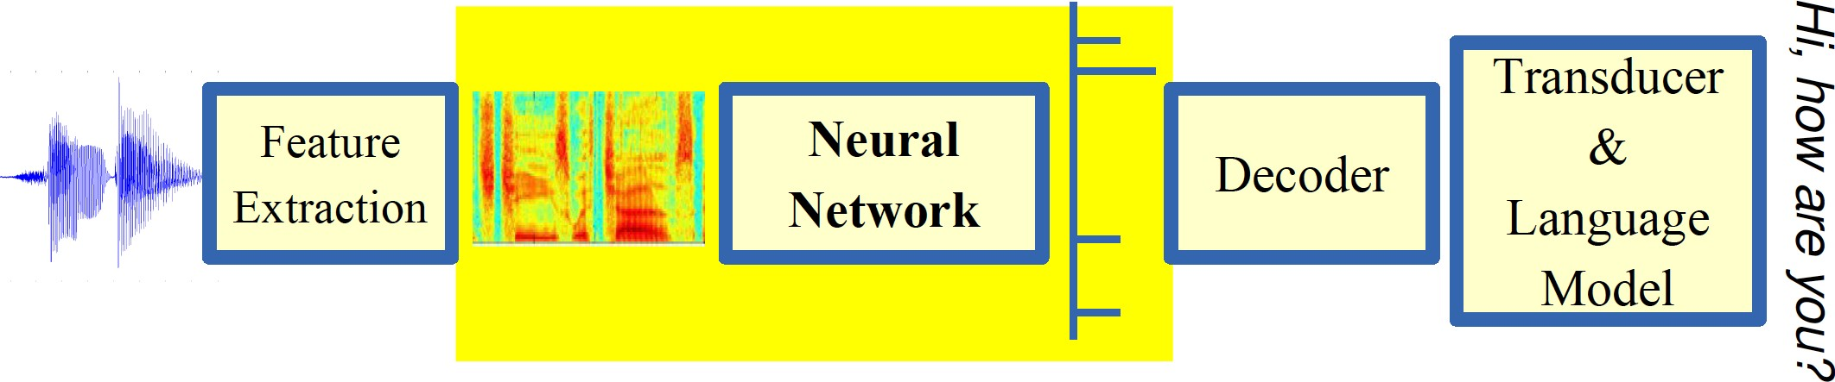
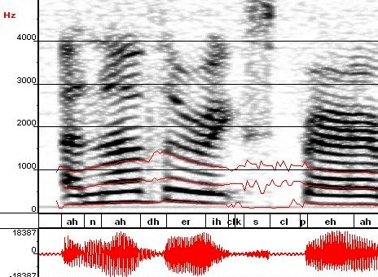
Automatic Speech Recognition
ML used to predict phoneme states from sound spectrogram Deep Learning Based Results
# Hidden Layers | 1 | 2 | 4 | 8 | 10 | 12
Word Error Rate % | 16.0 | 12.8 | 11.4 | 10.9 | 11.0 | 11.1
Baseline Gaussian Mixture Model based word error rate = 15.4%
[Zeiler et al. “On rectified linear units for speech recognition” ICASSP 2013]
Slide credit: Eric Eaton

Slide 29

Robotics

Slide 30
Types of Learning
Supervised (inductive) learning
Given: training data, desired outputs (labels)
Unsupervised learning
Given: training data (without desired outputs)
Semi-supervised learning
Given: training data + a few desired outputs
Reinforcement learning
Given: rewards from sequence of actions
Slide Credit: Eric Eaton

Slide 31




Supervised Learning: Regression
Given (x₁, y₁), (x₂, y₂), ..., (x_{n}, y_{n})
Learn a function f(x) to predict y given x
9
8
7
6
5
4
3
2
1
0
1970 1980
September Arctic Sea Ice Extent (1,000,000 sq km)
1990
2000
2010
2020
Year
Data from G. Witt. Journal of Statistics Education, Volume 21, Number 1 (2013) Slide Credit: Eric Eaton

Slide 32
Regression
y = f(x)
Training: given a training set of labeled examples {(x₁,y₁), …, (x_{N},y_{N})}, estimate the prediction function f by minimizing the prediction error on the training set
Testing: apply f to a never before seen test example x and output the predicted value y = f(x)
output
prediction function
features
Slide credit: L. Lazebnik

Slide 33



Regression Example
Apply a prediction function to a feature representation of the image to get the desired output:
f( ) = “apple”
f( ) = “tomato”
f( ) = “cow”
Slide credit: L. Lazebnik

Slide 34


















Supervised Learning: Classification
Given (x₁, y₁), (x₂, y₂), ..., (x_{n}, y_{n})
Learn a function f(x) to predict y given x
– y is categorical == classification
Breast Cancer (Malignant / Benign)
1(Malignant)
0(Benign)
Tumor Size
^{Predict Benign} Predict Malignant
Tumor Size
Slide Credit: Eric Eaton

Slide 35
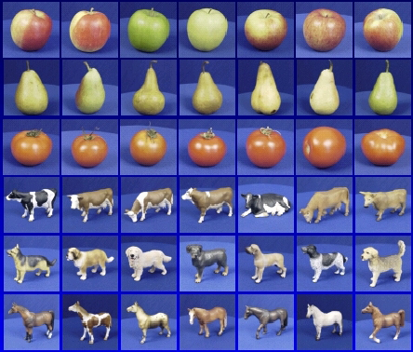

Classification
Training
Training Labels
Training Images
Features
Training
Learned model
Testing
Features
Learned model
Prediction
Test Image
Slide credit: D. Hoiem and L. Lazebnik

Slide 36















Unsupervised Learning
Given x₁, x₂, ..., x_{n} (without labels)
Output hidden structure behind the x’s
– E.g., clustering
Slide Credit: Eric Eaton

Slide 37











Unsupervised Learning
Organize computing clusters
Social network analysis
Market segmentation
Slide credit: Andrew Ng
Image credit: NASA/JPL-Caltech/E. Churchwell (Univ. of Wisconsin, Madison)
Astronomical data analysis

Slide 38
Reinforcement Learning
No predefined data
Semi-supervised learning model in machine learning,
Allow an agent to take actions and interact with an environment so as to maximize the total rewards.
Examples:
Resources management in computer clusters
Game playing
Robot in a maze
Slide Credit: Eric Eaton
Notes:
Reinforcement vs. Unsupervised Learning: Reinforcement Learning basically has a mapping structure that guides the machine from input to output. However, Unsupervised Learning has no such features present in it. In Unsupervised Learning, the machine focuses on the underlying task of locating the patterns rather than the mapping for progressing towards the end goal. For example, if the task for the machine is to suggest a good news update to a user, a Reinforcement Learning algorithm will look to get regular feedback from the user in question, and would then through the feedback build a reputable knowledge graph of all news related articles that the person may like. On the contrary, an Unsupervised Learning algorithm will try looking at many other articles that the person has read, similar to this one, and suggest something that matches the user’s preferences.

Slide 39
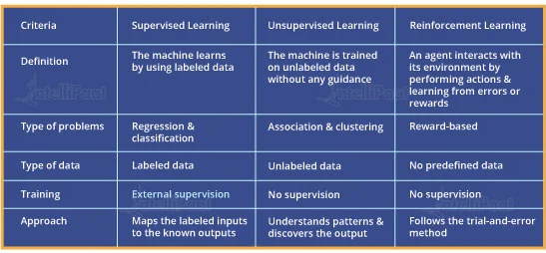
Supervised, Unsupervised and Reinforcement Learning Comparison

Slide 40
Open source ML programming tools
 | Platform | Algorithms or Features
Scikit Learn | Linux, Mac OS, Windows | Python, C, C++ | Classification, Regression, Clustering Preprocessing, Model Selection Dimensionality reduction.
PyTorch | Linux, Mac OS, Windows | Python, C++ | Autograd Module, Optim Module NN Module
TensorFlow | Linux, Mac OS, Windows | Python, C++ | Provides a library for dataflow programming.
Weka | Linux, Mac OS, Windows | Java | Data preparation, Classification Regression, Clustering, Visualization Association rules mining

Slide 41
Open source ML programming tools
Colab | Cloud Service | - | Supports libraries of PyTorch, Keras, TensorFlow, and OpenCV
Apache Mahout | Cross-platform | Java Scala | Preprocessors,Regression Clustering, Recommenders Distributed Linear Algebra.
Accors.Net | Cross-platform | C# | Classification, Regression, Distribution Clustering, Hypothesis Tests & Kernel Methods, Image, Audio & Signal. & Vision
Shogun | Windows Linux, UNIX Mac OS | C++ | Regression, Classification, Clustering Support vector machines. Dimensionality reduction, Online learning etc.
Keras.io | Cross-platform | Python | API for neural networks

Slide 42


Slide 43
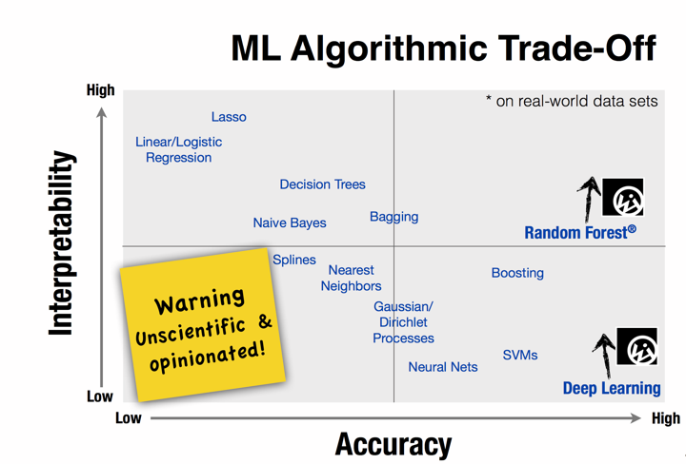

Slide 44
Design a Learning System

Slide 45






Designing a Learning System
Choose the training experience(data)
Choose exactly what is to be learned
– i.e. the target function
Choose how to represent the target function
Choose a learning algorithm to infer the target function from the experience
Training data
Learner
Environment/ Experience
Knowledge
Testing data
Performance Element
Slide Credit: Ray Mooney

Slide 46
Designing a Learning System: An Example
1. Problem Description (Ex: Playing checkers)
2. Choosing the Training Experience (data expressed as features)
3. Choosing the Target Function to be learnt (Ex: deciding next board position
4. Choosing a Representation for the Target Function (design a function as linear etc)
5. Choosing a Function Approximation Algorithm (parameters learning using loss function)
6. Final Design
30 August 2020

Slide 47
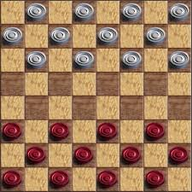
Choosing the training experience
In learning to play checkers, the system might learn from direct training examples consisting of individual checkers board states and the correct move for each.
Alternatively, it might have available only indirect information consisting of the move sequences and final outcomes of various games played.
30 August 2020

Slide 48
Choosing the training experience
In indirect training, information about the correctness of specific moves early in the game must be inferred indirectly from the fact that the game was eventually won or lost.
The learner faces an additional problem of credit assignment, or determining the degree to which each move in the sequence deserves credit or blame for the final outcome.
Credit assignment can be a particularly difficult problem because the game can be lost even when early moves are optimal, if these are followed later by poor moves. Hence, learning from direct training feedback is typically easier than learning from indirect feedback.
30 August 2020

Slide 49
Choosing the training experience
A second important attribute of the training experience is the degree to which the learner controls the sequence of training examples.
the learner might rely on the teacher to select informative board states and to provide the correct move for each.
the learner might itself propose board states that it finds particularly confusing and ask the teacher for the correct move.
30 August 2020

Slide 50
Choosing the training experience
A third important attribute of the training experience is how well it represents the distribution of examples over which the final system performance P must be measured.
learning is most reliable when the training examples follow a distribution similar to that of future test examples.
the performance metric P is the percent of games the system wins in the world tournament. If its training experience E consists only of games played against itself, there is an obvious danger that this training experience might not be fully representative of the distribution of situations over which it will later be tested.
30 August 2020

Slide 51
Choosing the training experience
For example, the learner might never encounter certain crucial board states that are very likely to be played by the human checkers champion.
it is often necessary to learn from a distribution of examples that is somewhat different from those on which the final system will be evaluated
one distribution of examples will not necessary lead to strong performance over some other distribution.
30 August 2020

Slide 52
Choosing the Target Function
ChooseMove, however, is difficult to learn.
An easier and related target function to learn is function
V: B --> R, which assigns a numerical score to each board. The better the board positions B, the higher the score R.
If the system can successfully learn such a target function V, then it can easily use it to select the best move from any current board position.
This can be accomplished by generating the successor board state produced by every legal move, then using V to choose the best successor state and therefore the best legal move.
30 August 2020

Slide 53
Choosing the Target Function
Let us therefore define the target value V(b) for an arbitrary board state b in B, as follows:
If b is a final board state that is won, then V(b) = 100
If b is a final board state that is lost, then V(b) = -100
If b is a final board state that is draw, then V(b) = 0
If b is a not a final state in the game, then V(b) = V(b’), where b' is the best final board state that can be achieved starting from b and playing optimally until the end of the game.
30 August 2020

Slide 54
Choosing the Target Function
This recursive definition specifies a value of V(b) for every board state b.
The goal of learning in this case is to discover an operational description of V i.e., a description that can be used by the checkers - playing program to evaluate states and select moves within realistic time bounds.
30 August 2020

Slide 55
Choosing the Target Function
Reduced the learning task to the problem of discovering an operational description of the ideal target function V – it is difficult to learn V perfectly.
We often expect learning algorithms to acquire only some approximation to the target function -- is called function approximation. [The actual function can often not be learned and must be approximated]
30 August 2020

Slide 56
Choosing a Representation for the Target Function
Expressiveness versus Training set size
More expressive the representation of the target function, the closer to the “truth” we can get.
More expressive the representation, the more training examples are necessary to choose among the large number of “representable” possibilities.
Example of a representation:
x1 = # of red pieces on the board, x2 = # of black pieces on the board
X3= # of black king on the board
x4 = # of red king on the board
X5 = # of black pieces threatened by black
x6 = # of red pieces threatened by black
V(b) = w0+w1.x1+w2.x2+w3.x3+w4.x4+w5.x5+w6.x6
^
wi’s are adjustable
or “learnable”
coefficients
IS ZC464, Machine Learning
30 August 2020

Slide 57
Choosing a Representation for the Target Function
w0 through w6 are numerical coefficients, or weights, to be chosen by the learning algorithm.
Learned values for the weights w1 through w6 will determine the relative importance of the various board features in determining the value of the board, whereas the weight w0 will provide an additive constant to the board value.
IS ZC464, Machine Learning
30 August 2020

Slide 58
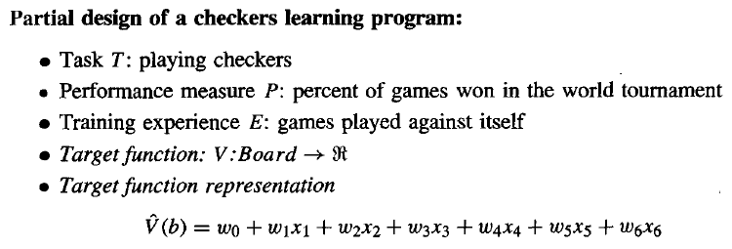
Choosing a Representation for the Target Function
30 August 2020

Slide 59
Choosing a Function Approximation Algorithm
Generating Training Examples of the form <b,Vtrain(b)> [e.g. <x1=3, x2=0, x3=1, x4=0, x5=0, x6=0, +100 (=blacks won)]
x1= # of black pieces on the board
x2 = # of red pieces on the board
x3 = # of black king on the board
x4 = # of red king on the board
x5 = # of black pieces threatened by red
x6 = # of red pieces threatened by black
30 August 2020

Slide 60
Choosing a Function Approximation Algorithm
Estimating the training Values
only training information available to learner is whether the game was eventually won or lost.
we require training examples that assign specific scores to specific board states.
easy to assign a value to board states that correspond to the end of the game,
less obvious how to assign training values to the more numerous intermediate board states that occur before the game's end.
fact that the game was eventually won or lost does not necessarily indicate that every board state along the game path was necessarily good or bad.
30 August 2020

Slide 61

Choosing a Function Approximation Algorithm
Estimating the training Values
Despite the ambiguity inherent in estimating training values for intermediate board states.
one simple approach is to assign the training value of Vtrain(b) for any intermediate board state b to be V(Successor(b)), where V is the learner's current approximation to V and where Successor(b) denotes the next board state following b
This rule for estimating training values can be summarized as
^
^
30 August 2020

Slide 62

Choosing a Function Approximation Algorithm
Adjust the weights
Specify the learning algorithm for choosing the weights wi to best fit the set of training examples {<b,Vtrain(b)> }.
One common approach is to define the best hypothesis, or set of weights, as that which minimizes the squared error E between the training values and the values predicted by the hypothesis V .
Thus, we seek the weights, or equivalently the V , that minimize E for the observed training examples.
^
^
30 August 2020

Slide 63
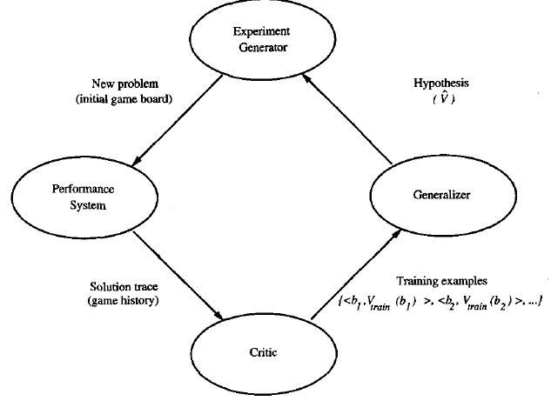
Final Design for Checkers Learning
IS ZC464, Machine Learning
30 August 2020

Slide 64
Final Design for Checkers Learning
The Performance Module (performance) : Takes as input a new board and outputs a trace of the game it played against itself.
The Critic (data generation) : Takes as input the trace of a game and outputs a set of training examples of the target function
The Generalizer (learner): Takes as input training examples and outputs a hypothesis which estimates the target function.
The Experiment Generator (task): Takes as input the current hypothesis (currently learned function) and outputs a new problem (an initial board state) for the performance system to explore
IS ZC464, Machine Learning
30 August 2020

Slide 65
Issues in Machine Learning
What algorithms are available for learning a concept? How well do they perform?
How much training data is sufficient to learn a concept with high confidence?
When is it useful to use prior knowledge?
Are some training examples more useful than others?
What are the best tasks for a system to learn?
What is the best way for a system to represent its knowledge?
30 August 2020

Slide 66
ML in a Nutshell
Tens of thousands of machine learning algorithms
Hundreds new every year
Every ML algorithm has three components
Representation
Optimization
Evaluation
Slide credit: Pedro Domingos

Slide 67
Evaluation
Accuracy
Precision and recall
Squared error
Likelihood
Posterior probability
Cost / Utility
Margin
Entropy
etc.
Slide credit: Pedro Domingos

Slide 68
Evaluating Performance
If y is discrete:
Accuracy: # correctly classified / # all test examples
Precision/recall
True Positive, False Positive, True Negative, False Negative
Precision = TP / (TP + FP) = # predicted true pos / # predicted pos
Recall = TP / (TP + FN) = # predicted true pos / # true pos
F-measure
= 2PR / (P + R)
Want evaluation metric to be in some range, e.g. [0 1]
0 = worst possible classifier, 1 = best possible classifier
Notes:
Diagnosis example

Slide 69
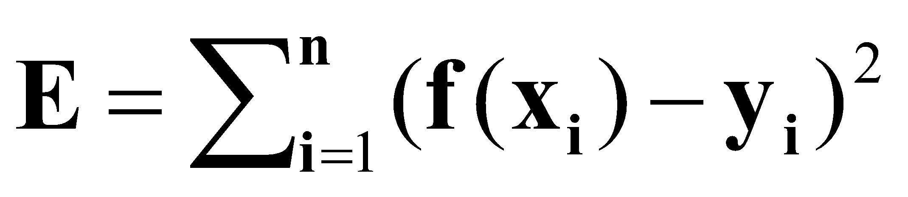
Evaluating Performance
If y is continuous:
Sum-of-Squared-Differences (SSD) error between predicted and true y:

Slide 70
Training vs Testing
What do we want?
High accuracy on training data?
No, high accuracy on unseen/new/test data!
Why is this tricky?
Training data
Features (x) and labels (y) used to learn mapping f
Test data
Features used to make a prediction
Labels only used to see how well we’ve learned f!!!
Validation data
Held-out set of the training data
Can use both features and labels to tune parameters of the model we’re learning
Slide Credit: Adriana Kovashka

Slide 71
Training vs. Test Distribution
We generally assume that training and test examples are independently drawn from the same overall distribution of data
– We call this “i.i.d” which stands for “independent and identically distributed”
Slide credit: Ray Mooney

Slide 72


ML in Practice
Understand domain, prior knowledge, and goals
Data integration, selection, cleaning, pre-processing, etc.
Learn models
Interpret results
Consolidate and deploy discovered knowledge
Loop
Based on a slide by Pedro Domingos

Slide 73
Recommended Readings
Tom M. Mitchell, Machine Learning, The McGraw-Hill Companies, Inc. International Edition 1997. [Ch. 1]
http://www.cs.princeton.edu/courses/archive/spr08/cos511/ [Web]
https://www.softwaretestinghelp.com/machine-learning-tools/
30 August 2020

Slide 74

Thank you for your time!!

